Slide 1
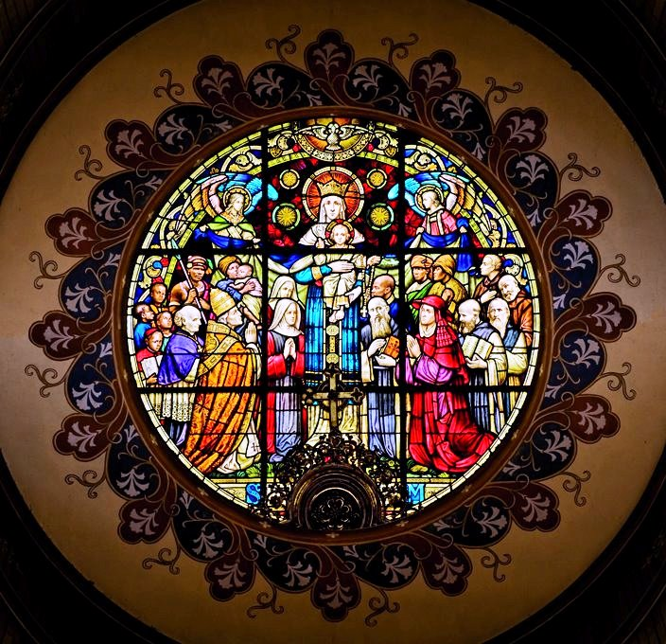
The story of Abbot Francis Pfanner and the Trappist monks, the Order of the Sisters of the Precious Blood; Chief Sakayedwa and his people; Edward Mnganga the first black priest from Umhlatazana South Africa to be trained in Rome; the suspension of the Abbot , the separation of the Trappists from their Order and the creation of a new order - the Congregation of Mariannhill Missionaries - CMM - is told in this stunning stained glass window in the church at Centocow Mission near Creighton

Slide 2
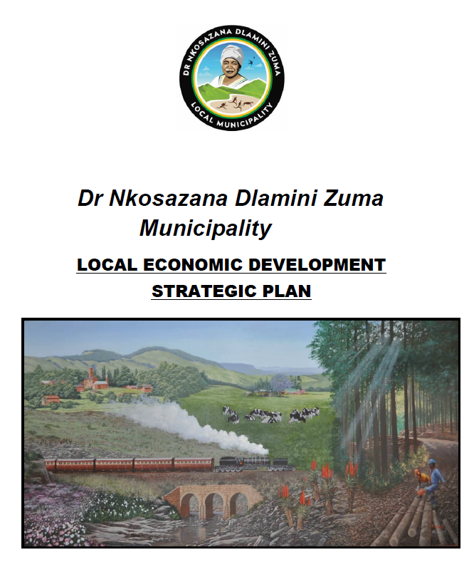
Why the Trappist Missions? The network of Trappist Missions was identified as a tourism strategy to be developed for this region in both the LED (Local Economic Development) plan and the IED (Integrated Development Plan) for 2017 – 2021.

Slide 3
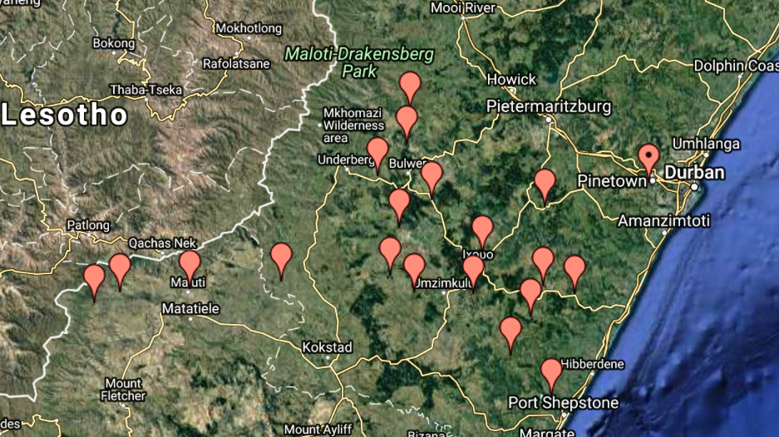
LED quote: “An audit undertaken of the….tourism assets indicated that the region was richly endowed with stunning and interesting scenery, pleasant climatic conditions, interesting cross-cultural diversity, sound infra-structure, safe and hospitable environment etc, however none of these was unique to the region. One needed to identify the comparative advantages which could be developed into niche brands to create a competitive tourism destination.”
One of the three comparative advantages which were identified were the historic network of Catholic Missions.

Slide 4
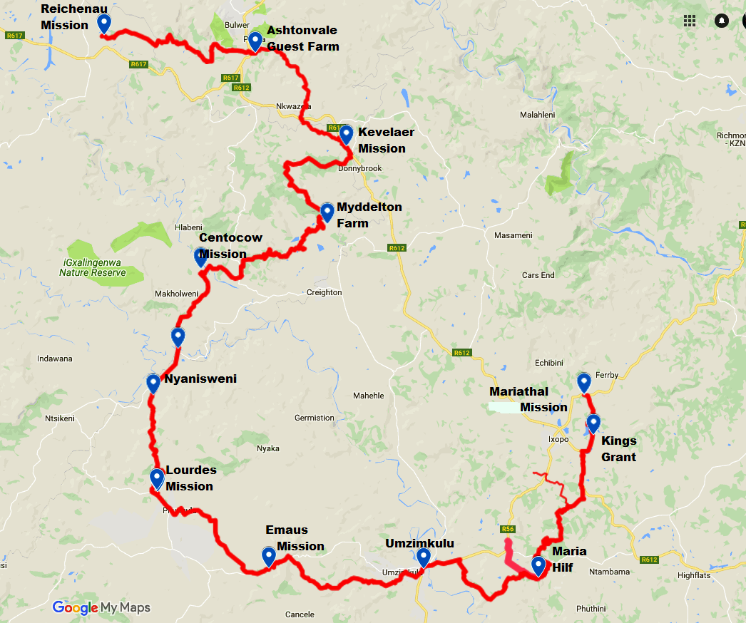
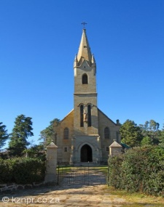
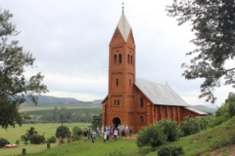
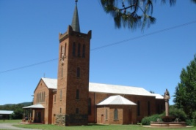
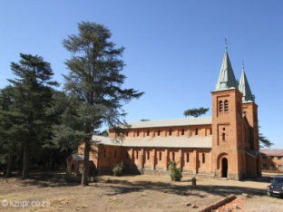
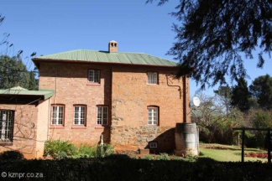
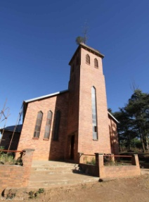
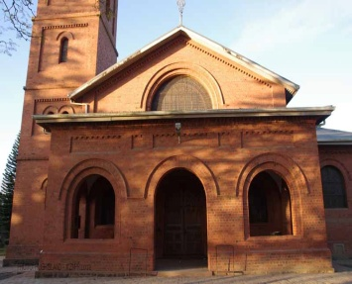
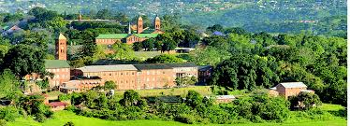
OUR VISION FOR MISSION TRAILS
In July 2017 we proposed developing a 250 km trail linking 9 Missions from Reichenau near Underberg to Einsiedeln near Eston and back to Mariannhill. Due to challenges on the last 85km we have not developed trails to Mariannhill yet so for now we have a 165 km trail linking 8 Missions as far as Mariathal outside Ixopo.

Slide 5
BENEFITS OF TRAPPIST MISSION TRAILS AND TOURS
TO THE CHURCH, THE COMMUNITY AND THE COUNTRY
Religious/Cultural tourism is the fastest growing category of tourism world-wide but there are very few religious tourist destinations in South Africa.
The APT Trail is the first religious pilgrimage trail that leads from one Trappist Mission to the next.
An increase in regular numbers of pilgrims and tourists to the Missions will have a knock-on effect for local businesses and the community.
Higher demands for accommodation and entertainment, food, beverage and transport can create new jobs and employment opportunities, not only in established industries but for small business like local crafts and souvenir suppliers, local walking guides and taxi-transport operators.
In order to support the upkeep and repair of the Missions, each tour operator costs in a donation to the Church as part of the tour package. Members of the groups are encouraged to give individual donations to the churches as well.
When the tours become popular with overseas pilgrims and tourists, this will create foreign exchange benefits for the country.

Slide 6
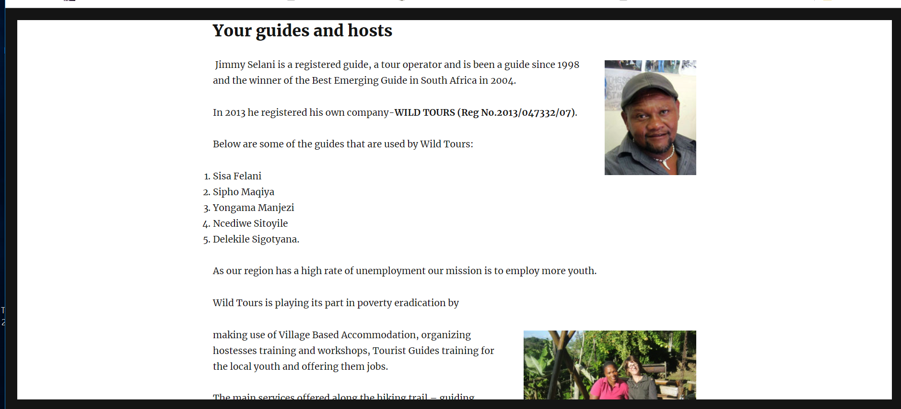
Our long term goal is for a local tour operator to develop Village-to-Village tours similar to the one on the Wild Coast that offers Xhosa Cultural tours staying in villages instead of B&B’s, hotels or guest farms.
Overnight accommodation is provided in hikers’ huts or in Xhosa huts in the villages. The huts are well located to provide for a good day’s hike along the coast and are beautifully situated. When accommodation is provided in a village, you stay with the community in a separate hut with a shower and toilet. These guest homes provide basic service standards and traditional hospitality. Your stay in the villages will give you a chance to meet and befriend the communities. Accommodation includes, bedding, breakfast and dinner.
http://wildcoasthikes.com/ is owned by a Xhosa Tour Guide – Jimmy Selani

Slide 7
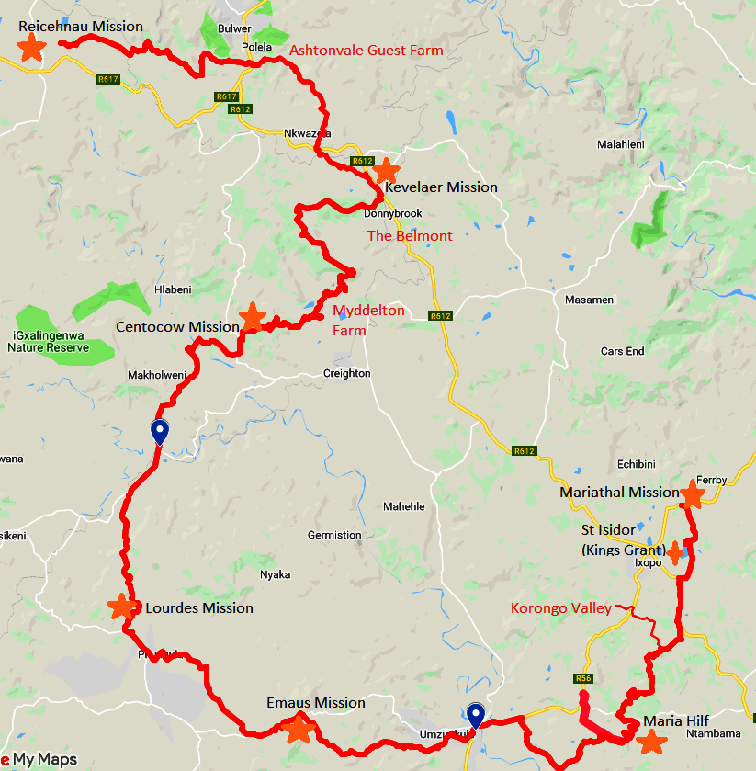
ABBOT PFANNER TRAPPIST TRAIL
& TRAPPIST WAY CYCLE TOURS

Slide 8
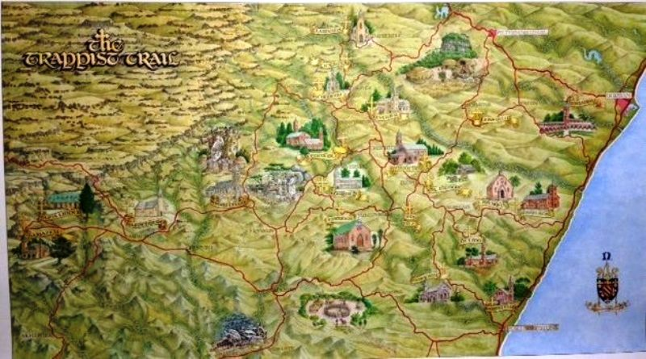
1: 2017 July
First meeting in Durban
4: 2017 November
1st trail finding teams under Jon Stevens created some of the trails
6: 2018 March
1st hiking group tested
trails and accommodation for 12 days
5: 2018 January
2nd trail finding teams created the rest
2: 2017 October
Meeting in Underberg
3: Support from the Diocese, Bishops, priests and locals
7: 2018 September
First official group led by Jenny tested a
9-day trail
8: 2018 October
Finn and I led a group testing a ‘Walk-and-Ride” group for 6 days
9: 2018 November
Spekboom Tours tested a 5-day Cycle Tour trail

Slide 9
The off-road hiking trail was named the Abbot Pfanner Trappist Trail [APT Trail]

Slide 10
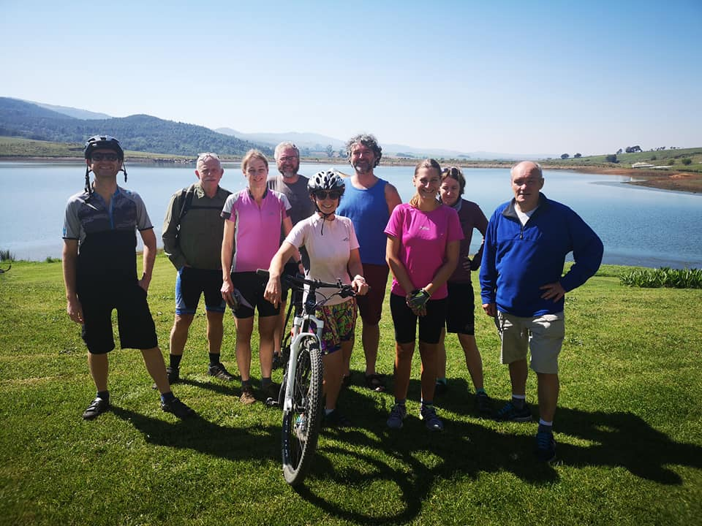
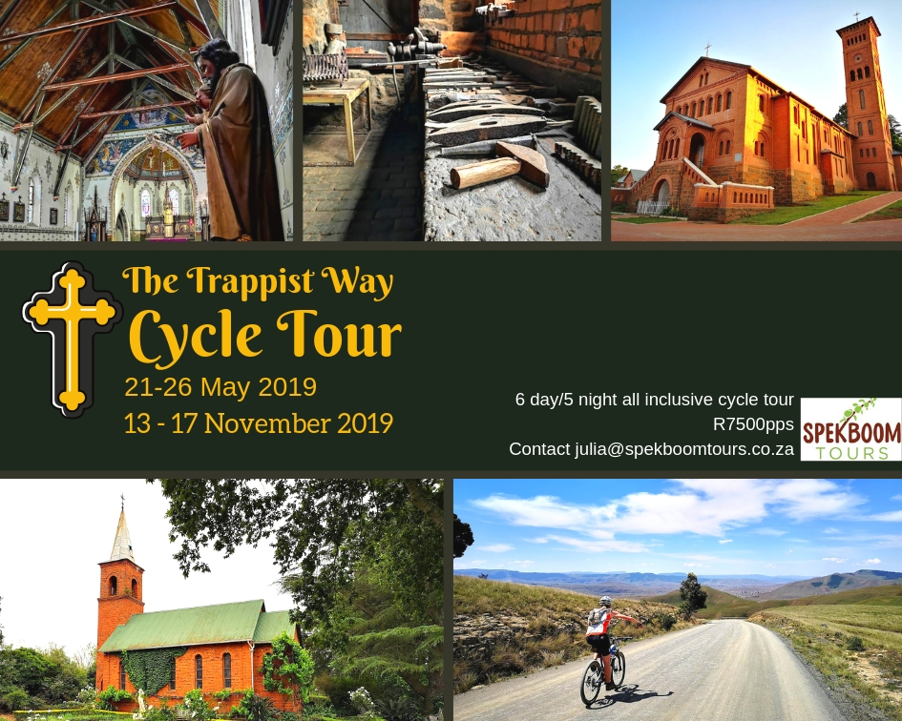
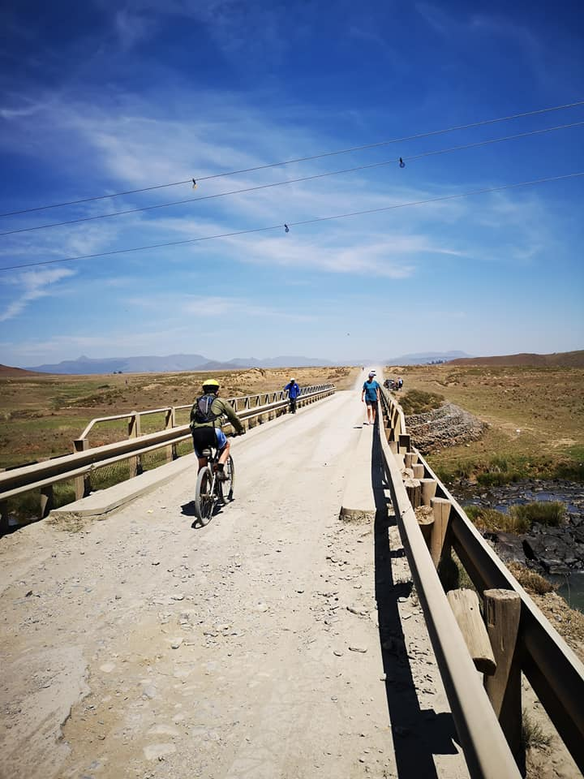
The Cycle tour is called the TRAPPIST WAY
Created by Julia Colvin and her team of cyclists, this is
for ordinary cyclists and is not an extreme MTB trail

Slide 11
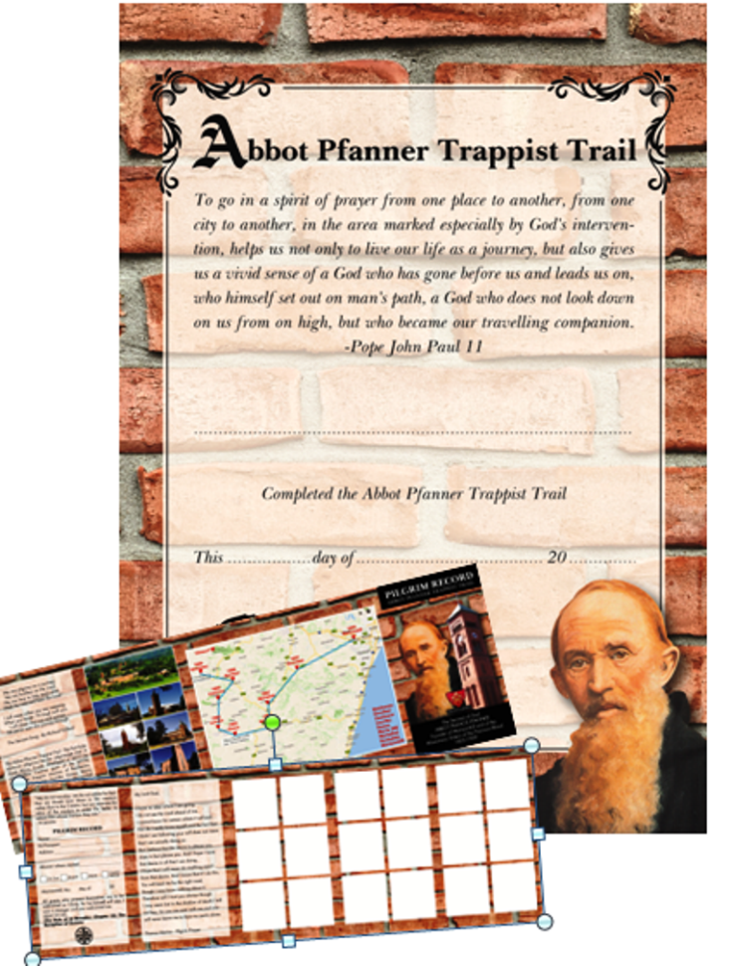
APT TRAIL SYMBOLS, SOUVENIRS AND CERTIFICATES
Pilgrims can wear an Abbot Pfanner pin in their hat and a Trappist Cross on their backpacks, which identifies them as APT Trail pilgrims. They can also buy APT Trail t-shirts, golf shirts and badges created at the Umzimkulu Diocese in Harding.
They can carry a folding ‘pilgrim passport’ or Trail Credential that is stamped at each mission.
Walking pilgrims take 9 or 6 days to cover the trail, cycling and mountain bikers a few days less.
When they arrive at Mariannhill they are given an APT Trail certificate of completion.

Slide 12
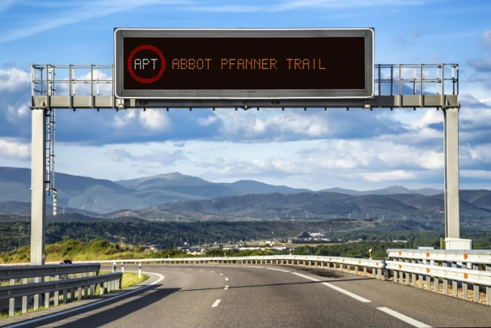
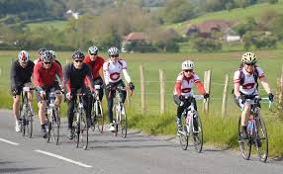
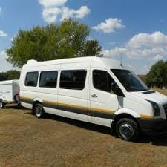
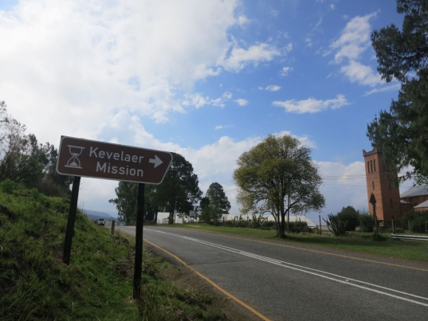
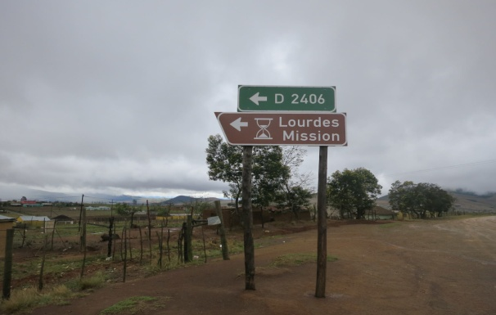
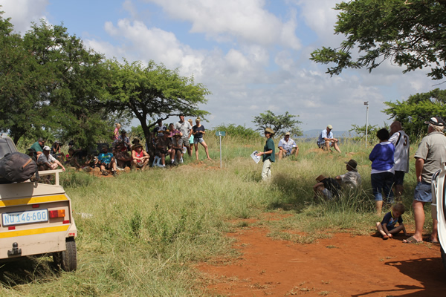
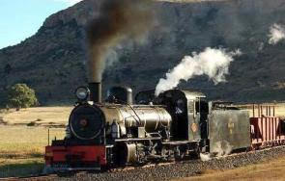
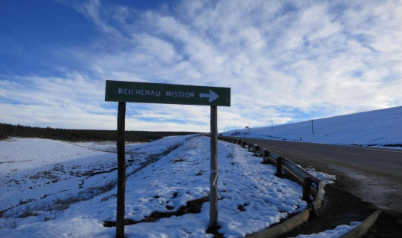
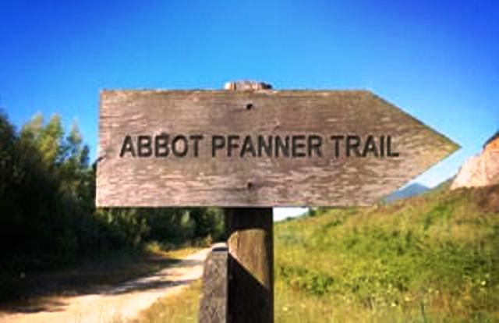
In conjunction with the off road Trappist Trail, a road trail could be improved for cyclists, small coach tours, tour-guides leading people in their own vehicles and tours combining the Railway and coach tours

Slide 13
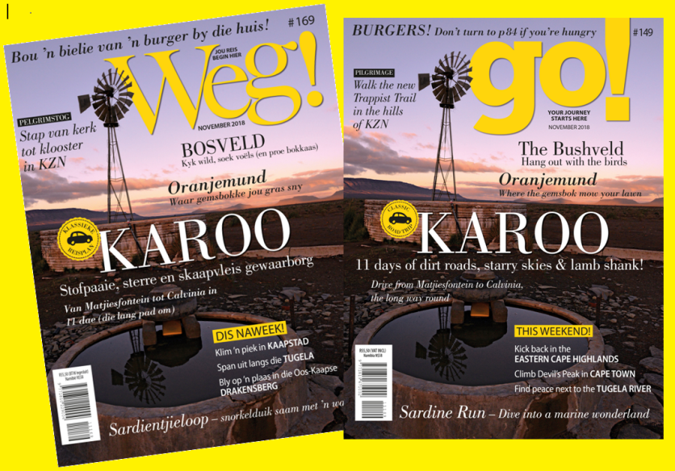
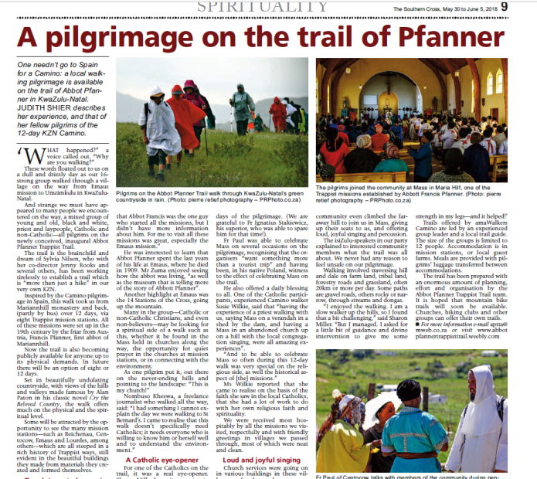
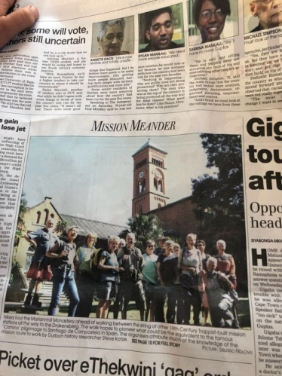
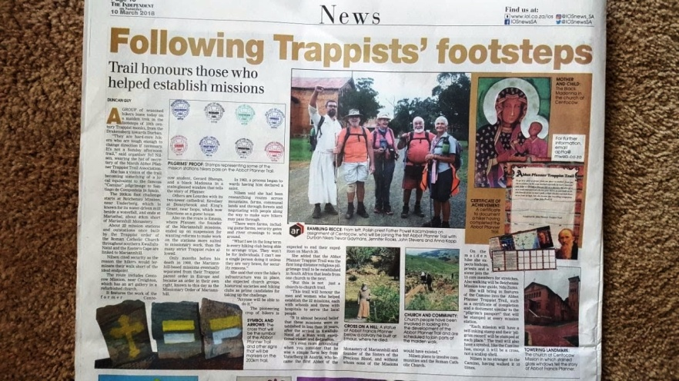
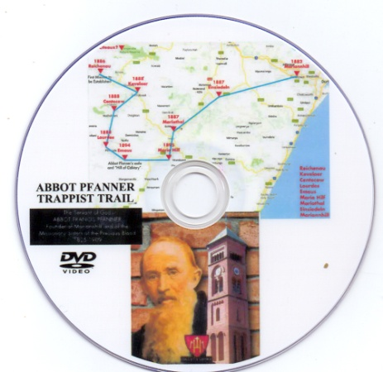
IN THE MEDIA

Slide 14
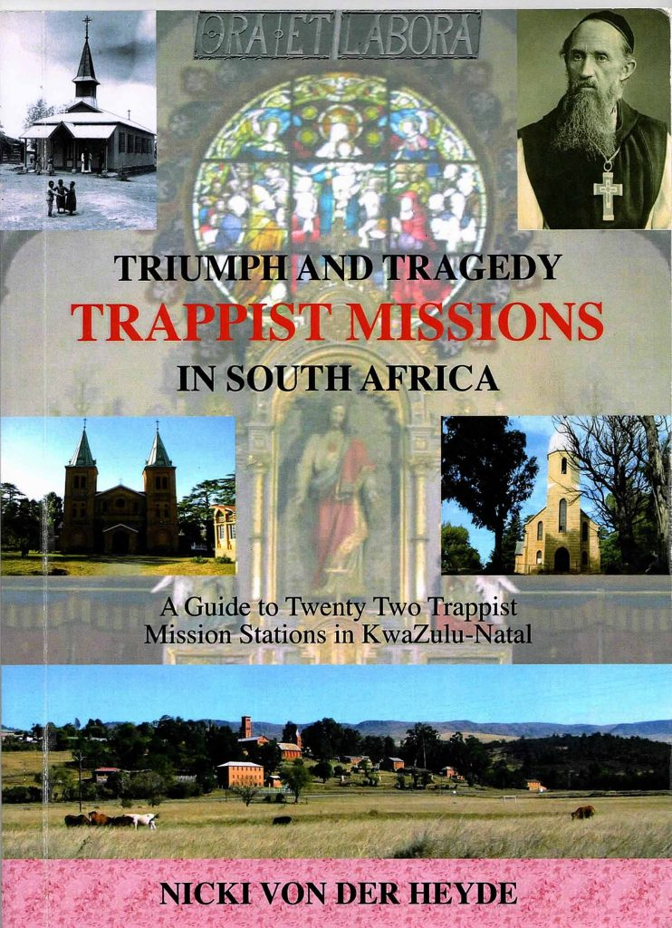
Essential reading
The only book that describes all of the Trappist Missions established by Abbot Francis Pfanner and his monks in the 19th century.

Slide 15
ON THE INTERNET
APT Trail: https://abbotpfannertrappisttrail.weebly.com/
Book a trail: www.amawalkerscamino.com/abbot-pfanner-trappist-trail.html
FACEBOOK: https://www.facebook.com/groups/344578699304372/
Trappist Trail Documentary: https://www.youtube.com/watch?v=Fh2DiHPAaZ0
APT Trail – March 2018: (Slide show of photographs) https://www.youtube.com/watch?v=iEXsvhpD8YA
In the Footsteps of the Trappists – 21 missions: https://www.youtube.com/watch?v=dpzysVpsAhI&feature=youtu.be
“HOSANNA” Filmed on the APT Trail – aired on SABC: https://youtu.be/lY3W8vyicW4

